Slide 1
Presentation by
Muhammad Raees (mr2714@rit.edu)
Sujan Dutta (sd2516@rit.edu
Project 2
Unconstrained Optimization

Slide 2
Contents
Overview
Optimization Methods
Results and Analysis
Conclusion

Slide 3
Overview
We implemented the three required methods
  Gradient Descent
  Newton
  Quasi-Newton
And two additional methods
  Marquardt
  Polak-Ribiere Conjugate Gradient
Marquardt method is a mixture of the gradient descent and newton.
Polak-Ribiere is a variation of the nonlinear Fletcher-Reeves Conjugate Gradient method.

Slide 4


Overview
Marquardt algorithm, uses hessian computation, to solve non-linear optimization problems.
At each step
  Marquardt modifies the hessian elements:
  γ is a sufficiently large positive constant, I is the identity matrix. The descent direction is given by:

Slide 5


Overview
In Polak-Ribiere, the parameter is given by
  The new descent direction is calculated by

Slide 6
Overview
In the overall test runs, mostly
  Gradient descent has the slowest convergence
    but simple computation
  Newton method has the fastest convergence
    but requires hessian computation
We tested the methods with alpha values (0, 1).
  Increasing alpha positively affects the newton, quasi-newton, and Marquardt on the number of iterations.
The final results are reported on the following parameters.
  𝛂 = 1; tolerance = 0.000001; max iterations=1000.
  c1 = 0.2; c2 = 0.5; (Line search parameters)

Slide 7
Function 1 Optimization
Sr. | Optimization Method | X= [-49:1:50] |  | X= randi ([1 10],1,100)
 |  | Min(f(x)) | Iterations | Min(f(x)) | Iterations
1 | Gradient Descent | 2.5979e-05 | 412 | 3.0451e-05 | 236
2 | Newton | 0 | 1 | 0 | 1
3 | Quasi-Newton | 1.7504e-05 | 96 | 2.8689e-06 | 84
4 | Marquardt | 3.9358e-07 | 7 | 9.6820e-07 | 7
5 | Polak-Ribiere Conjugate Gradient | 2.8671e-15 | 149 | 7.5017e-15 | 106

Slide 8
Function 1 Optimization
The newton method converges to the solution in one iteration (quadratic) function.
  reducing the alpha value increases the number of iterations and convergence (minima).
Gradient descent is simple but the slowest to converge
  dependent on the scale of the problem and input.
  higher numbers in the input change the iteration counts and convergence (minima).

Slide 9
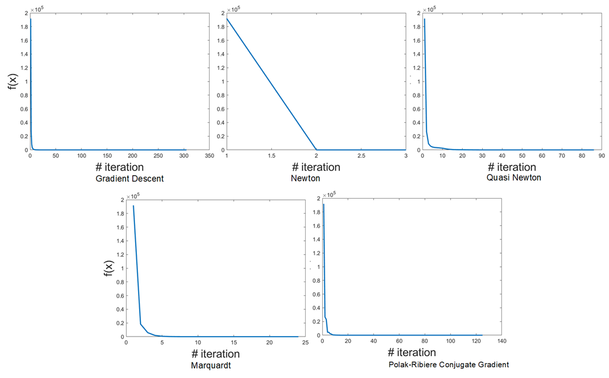
Function 1 Convergence

Slide 10
Function 2 Optimization
Sr. | Optimization Method | X= zeros (100,1)
 |  | Min(f(x)) | Iterations
1 | Gradient Descent | -2.4431e+03 | 1000
2 | Newton | -2.4432e+03 | 9
3 | Quasi-Newton | -2.4432e+03 | 174
4 | Marquardt | -2.4432e+03 | 12
5 | Polak-Ribiere Conjugate Gradient | -2.4431e+03 | 1000

Slide 11
Function 2 Optimization
The function is only defined when the condition: b_{i} - a_{i}^{T} x>0 is met.
  at each iteration, we check if this condition holds.
The methods reach to almost same minima but each takes different number of iterations.
The function is tested on the input vector of zeros. The performance of the function on other inputs is inconclusive.

Slide 12

Function 3 Optimization
Sr. | Optimization Method | X= [1.3;1.5] |  | X= [2;1]
 |  | Min(f(x)) | Iterations | Min(f(x)) | Iterations
1 | Gradient Descent | 1.0119e-0 | 632 | 5.9693e-04 | 183
2 | Newton | 3.6556e-07 | 7 | 9.2788e-08 | 13
3 | Quasi-Newton | 2.5628e-07 | 8 | 2.6687e-07 | 17
4 | Marquardt | 9.3137e-07 | 18 | 1.9205e-06 | 25
5 | Polak-Ribiere Conjugate Gradient | 1.1739e-12 | 332 | 1.2111e-12 | 841

Slide 13
Function 3 Optimization
The global minima (0) of the function occur at point (1; 1).
The function is more sensitive to the input.
  small change in input results in big change in performance of methods
Again, gradient descent takes a longer time to converge and the Newton method is the fastest.

Slide 14
Impact of Changing Alpha
Method | Alpha | F1 | F2 | F3
Gradient Descent | 0.1 | 2.0518e-05 (214) | -2.4432e+03 (1000) | 2.6802e-03 (1000)
 | 0.5 | 3.3556e-05 (233) | -2.4431e+03 (1000) | 5.9693e-04 (183)
 | 1.0 | 3.0131e-05 (307) | -2.4431e+03 (1000) | 5.9693e-04 (183)
Newton | 0.1 | 4.6423e-06 (116) | -2.4432e+03 (77) | 4.5233e-06 (132)
 | 0.5 | 6.5346e-07 (19) | -2.4432e+03 (16) | 1.3334e-06 (28)
 | 1.0 | 0 (1) | -2.4432e+03 (9) | 9.2788e-08 (13)
Quasi-Newton | 0.1 | 2.4116e-06 (89) | -2.4432e+03 (120) | 2.9900e-05 (32)
 | 0.5 | 1.1083e-05 (84) | -2.4432e+03 (193) | 4.9942e-07 (29)
 | 1.0 | 2.0188e-06 (89) | -2.4432e+03 (174) | 2.6687e-07 (17)
Marquardt | 0.1 | 4.6851e-06 (117) | -2.4432e+03 (84) | 1.0936e-05 (198)
 | 0.5 | 8.2314e-07 (19) | -2.4432e+03 (21) | 2.1280e-06 (42)
 | 1.0 | 1.0241e-07 (6) | -2.4432e+03 (12) | 1.3560e-06 (19)
Polak-Ribieri | 0.1 | 2.1210e-13 (314) | -2.4429e+03 (1000) | 5.9738e-12 (1000)
 | 0.5 | 3.0027e-14 (127) | -2.4430e+03 (1000) | 1.2211e-12 (834)
 | 1.0 | 5.7222e-14 (125) | -2.4430e+03 (1000) | 1.2111e-12 (841)

Slide 15
Conclusion
The objective functions are optimized using the five optimization methods.
  The hessian methods are faster to converge.
  The increase in learning rate betters the convergence of hessian methods.
  That is not the case for gradient descent and conjugate descent methods.
Function 2 is troublesome
  requires the constraint b - Ax > 0.
  Maybe methods are not ideal for the optimization of this function.
  The performance of methods does not vary much (which can be a limitation for optimization)

Slide 16
Thank you!
Questions?

